Slide 1
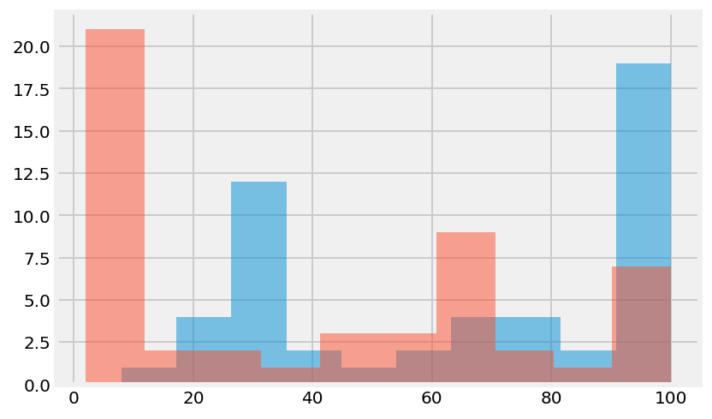
Do You Live in a State That Requires ACT or SAT Testing?
In most of the states SAT is not required to be taken as the frequency of 20 can be observed for participation rate of less than 10%
Whereas frequency of almost 19 is demonstrated 100% of participation at ACT test
It can be observed from scatterplot that there is almost no overlapping between participation in ACT and SAT tests thus most students taking one of the exam tend not to sit the other exam

Slide 2
Math score distribution for SAT and ACT Verbal score distribution for SAT and ACT
Math score distribution for SAT shows the peak at 500, the shape of the distribution is more centered around the peak than that of ACT math score
Math score for ACT demonstrates the peak at 20, the shape of distribution is wider and the variance is higher than that of SAT exam
Verbal score distribution for SAT test shows two peaks at 550 and 650
Verbal distribution for ACT reading test show higher peak at 21 and lower peak at 25
The width of Verbal distribution is similar in both tests

Slide 3
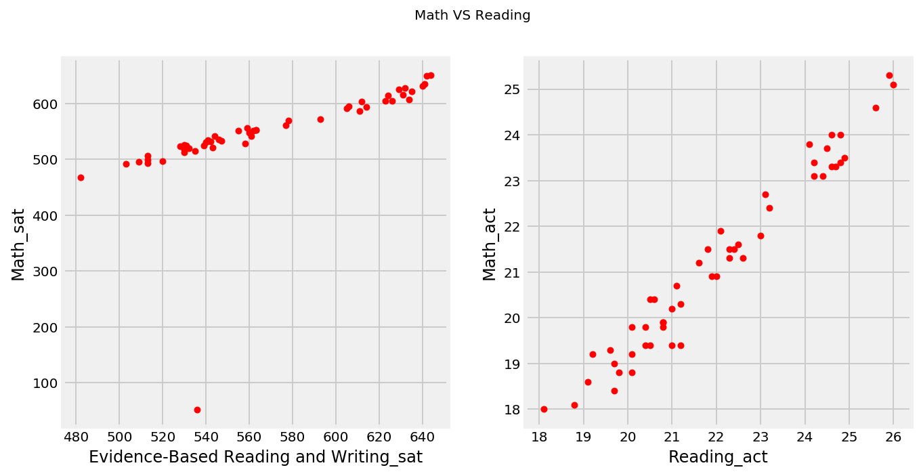
Distribution of Math vs Reading in SAT and ACT exams
The distribution of Math vs Verbal score in SAT is linear as the distribution of Math vs Verbal score in ACT. However, distribution in ACT is more steep than that of SAT distribution. The positive correlation of the data indicates that students that score high in Math tend to score high in Verbal part as well and student that show poor knowledge in Math equally fail in verbal part of the test as well.
The shallowness of the linear relationship in SAT test shows that in general students tend to do well in Math during SAT test, the scores are in range of 450-700 with only outlier at 50. Whereas in ACT test, Math score ranges between 18 till 26 and corresponds to gradual increase in Verbal score of the same test. It also might show that Math section in ACT test is generally harder to tackle than that of SAT test.

Slide 4
SAT total score vs SAT participation test
SAT total score tend to be lower where the participation rate is 100% compared to the total score at the range of participation rate of 0-10
It might be because in states where the test is not compulsory the test is taken mostly by brightest students aiming to get into highly competitive universities while in states where it is compulsory it is taken by all student decreasing the average to the score of 1000

Slide 5
Hypothesis test
H0: The mean difference between SAT Participation and ACT Particiaption is zero.
H1: The mean difference between SAT Participation and ACT Particiaption — is different than zero.
The p value is 0.00024134203698662353 and much less than 0.05 thus we reject Ho hypothesis, thus there is statistical difference between two groups. The participation rate might be different for these two tests.

Slide 6
Total score vs Verbal score and Total score vs Math score in SAT test
SAT Total score has linear relationship with both verbal and quantitative
sections of the test but the slope for each section is different

Slide 7
All variable boxplot for ACT test

Slide 8
ACT test scores have linear correlation between it’s sections

Slide 9
The distribution of all variables

